Slide 1
CDT PRESENTATION
TOPIC : “Improvement in women’s safety in our locality”
Batch : B1
Submitted by :-
Sr. No. | Name | Roll No | PRN No
1. | Nidhi Agrawal | 222002 | 22110453
2. | Shashank Bankar | 222006 | 22110478
3. | Urvashi Bhalerao | 222010 | 22111286
4. | Rushikesh Chaure | 222016 | 22111006

Slide 2

Introduction to problem
Women have the right to be free from violence, harassment and discrimination and removing the barriers of an unsafe environment can help women fulfil their potential as individuals and as contributors to work, communities and economies.
In every locality women face such kind of problems leading to restrictions in development of women .
Women don't have a safe environment and equal freedom to roam around and gather equal amount of opportunities as other gender would get.
In order to reduce this problems faced by the women and make a safe environment for them we are doing research.
We are looking for the ways by which we can make places safer for women and to educate right things to people and spread awareness regarding it.

Slide 3
Ways of user research
Analysis of user research
For gathering the information from the localities about their experience or any such thing that they have noticed or have come across, we have used the following ways:-
1. Firstly we have created a google form.
2. We have circulated it in our college via official email to all the students and through whatsapp groups as well.
3. Peer to peer conversation and made our surrounding people aware of the survey form.
Problems addressed by women in daily life:
Harassment
Stalking
Domestic violence
Economic Inequality
Receiving creepy messages on social media
Dressing issues
Lack of police patrolling
Inadequate transport

Slide 4
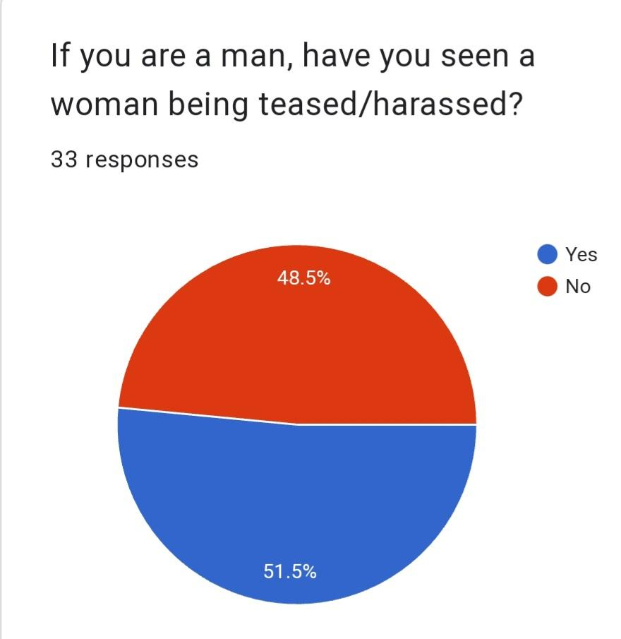
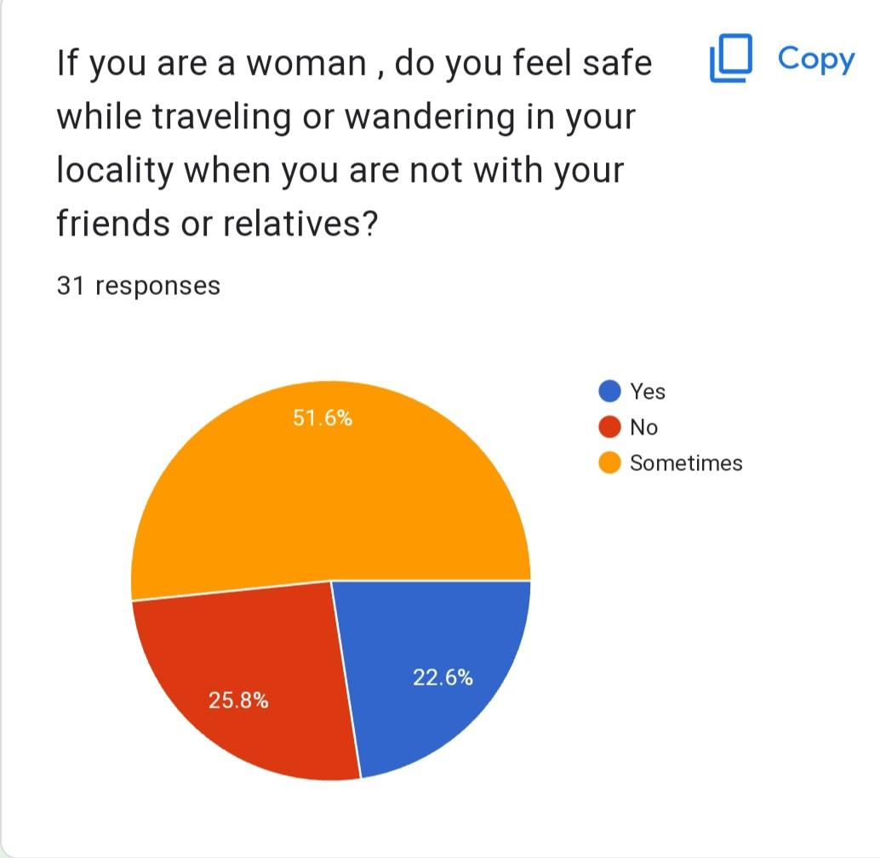
Analysis of user research
Harassment
Stalking

Slide 5
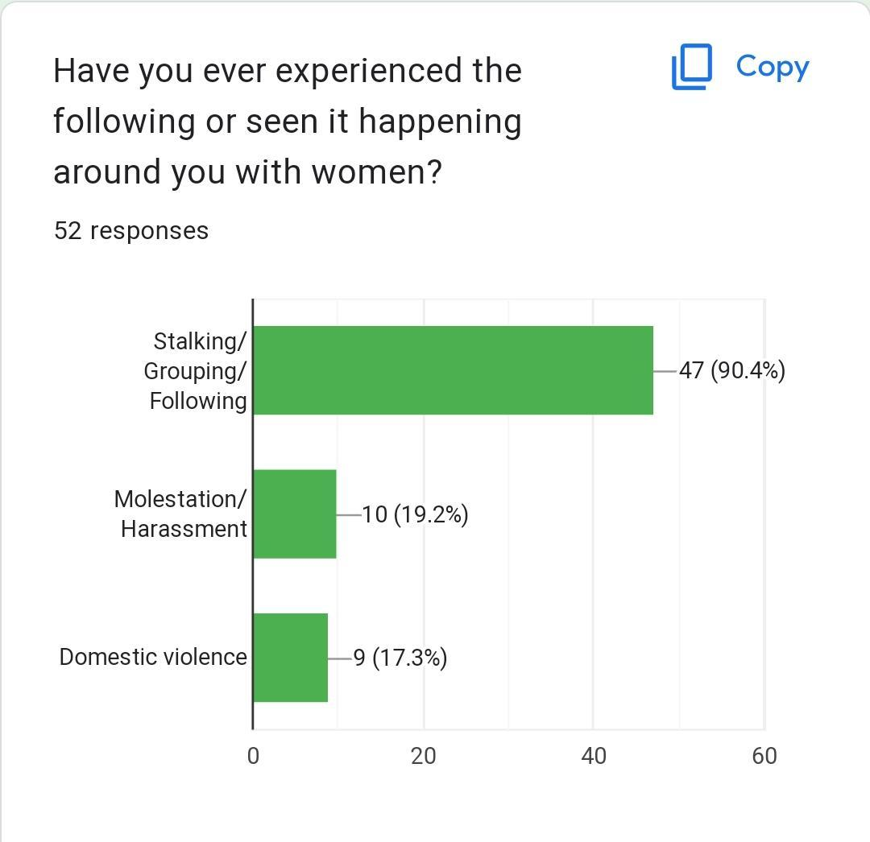
Domestic violence

Slide 6
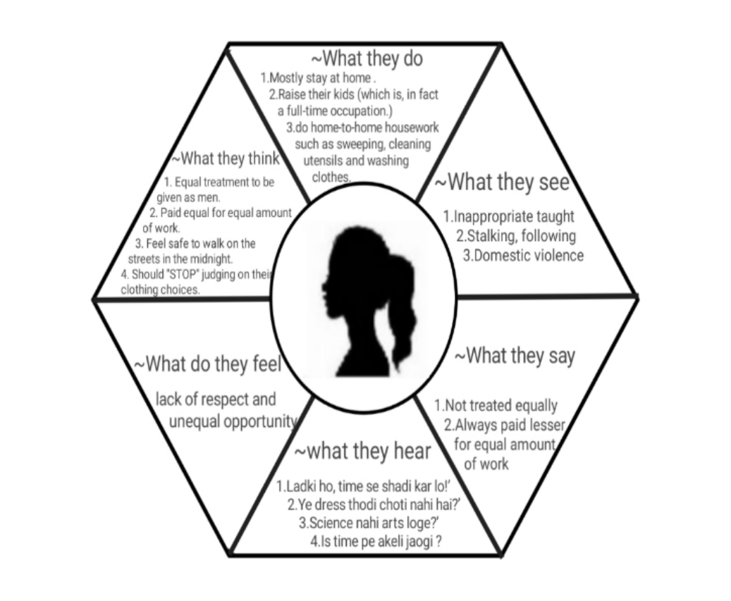
EMPATHY MAP
Use of the map
Improve customer experiences.
Plan communications and design marketing.
To extrapolate what needs to be done to increase customer engagement and satisfaction.

Slide 7
Techniques of Ideation.
Brainstorming
Worst idea
Storyboarding
Mind Mapping
Sketching
Bodystorm

Slide 8
TOP SOLUTIONS
Educate the next generations
Promote gender equality through feminism
Stop the ridiculous culture of keeping boys and girls apart at a young age.
Remove the patriarchal mindset still dominant in India
Problems faced by the technical solutions is that society currently is not handy with the use technology , so you don’t easily find a tracker kind of apps in any woman’s mobile.
Do even you have it?

Slide 9
Story telling

Slide 10
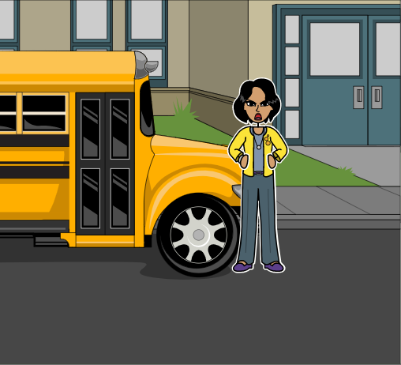
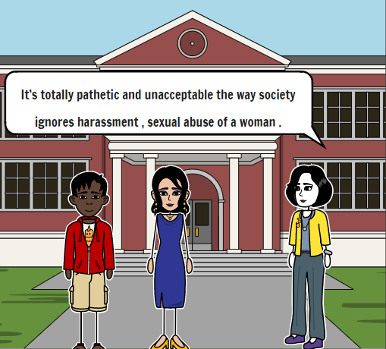
(Rashi has reached college after traveling for hours in public bus. She meets her friends Raj ,Hrishi and Usha in college and narrates what did she experience in the bus .)

Slide 11
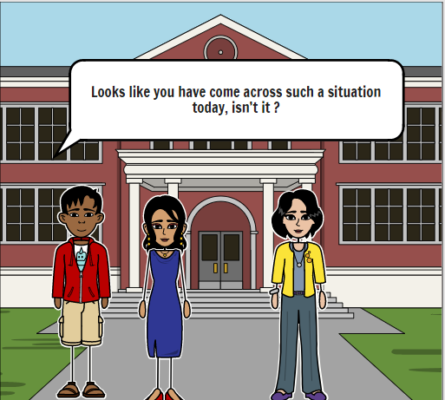
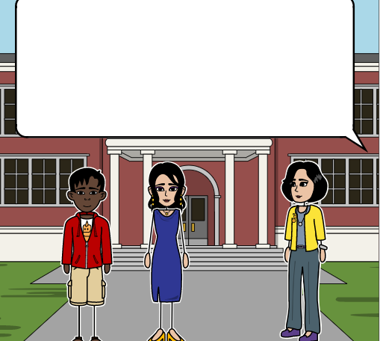
Absolutely correct! I was travelling in the bus.There was a guy who was sitting on the reserved seats for women and no one was even questioning him.I asked him to leave that seat . He refused me to do so and started using bad words for me .I was kind of shocked by this kind of behaviour as it was my first experience of such type .But thanks to the TC who came and stood by me and ordered that guy to get out of that seat .The guy did it after exchange of few words between him and the TC.But I noticed there was no sense of regret on his face.

Slide 12
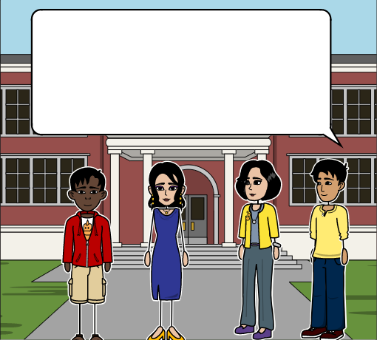
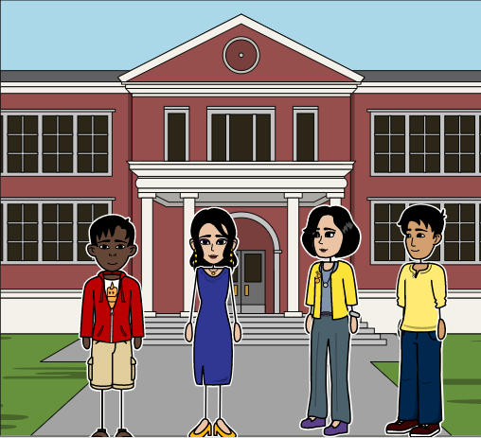
These kind of people are mentally sick , but the point to notice here is the one’s we call educated also didn’t come to save you or take a stand for you.Is this the way we are going to empower the women ?
We’ve seen worse cases of harassment,sexual abuse and gender discrimination in our country , in our surroundings .It seems like repetitive occurrence of such events have made the society insensitive towards such a serious issue.Nowdays people just read and forget the cases of acid attacks , dowry related harassment ,gender pay gap etc.

Slide 13
I feel not only the society , we as an individual also lack some feeling of responsibility and some basic precautionary measures that one should follow to ensure security of one self as well as someone who is in such kind of situations . We have to start making the change rather than to wait for society to change completely .Until we get a fully safe environment we should be very careful about what places we visit at what point of time , whom we go out with , do we tell someone at home about where am I going ,when am I going .Carrying pepper sprays in our purse .This kind of measures can really help to not fall for these situations .
It’s really shameful that you need to do all such stuff just for the sake of getting equal amount of freedom of roaming ,traveling around but this is the best we can start with at the individual level . Having your close one’s added to the emergency dialer in your mobile is also a good preventing measure . While going to a unknown location , one should share the live location to someone that will help them track you .At some places police have also implemented pick-and-drop facility for women. Having knowledge of such things makes it crucial to avoid such events.

Slide 14

When we are done with individual level of contributions ,we should be looking at what can we do as a collective members of society . Wherever we spot such kind of event happening we should immediately call for help .We should be demanding CCTV cameras in public places to have surveillance.Ensuring women safety is not about not letting her travel to unsafe places , It's about making places safer for her.

Slide 15
Conclusion OF RESEARCH
Self-defense routines are the first and foremost method that every woman must be mindful of and have sufficient self-defense practice for their security.
Women should carry all the emergency numbers
with them and women helpline number in case of any emergency.
Pepper spray can also be used as a self-
defense tool,women should not depend completely on it and use other methods as well.

Slide 16
Conclusion
The day women in India will feel safe to do the
most basic things like going to nearby shops
without the fear of anything is when we will truly
succeed as a country. The moment every citizen
understands what consent is and starts
respecting the women around them is when we
can truly accomplish the dream that our
predecessors dreamt of.

Slide 17
THANK YOU !!

